Slide 1
CALCULATOR
NextHikes
IT Solutions
Nazia Akhter

Slide 2
OVERVIEW
Developed a GUI Calculator using Python and Tkinter.
Supports arithmetic operations: addition, subtraction, multiplication, division and percentage.
User-friendly interface with buttons for digits and operators.
Input handling calculation logic and error validation implemented in python.
Suitable for beginners learning GUI programming and small python application development.

Slide 3
LIBRARIES USED
Tkinter
  Primary Library used for building the GUI (Graphical User Interface)
  Provides widgets like Buttons, Entry, Frame, Labels.
  Eval () used for evaluating mathematical expression typed into the calculator.
  Basic Python string manipulation and variable handling (no external libraries required)
  VS Code Python Extension – Development and debugging support.
  Clear button to reset the input field.

Slide 4
Challenges faced
Aligning Buttons and entry fields properly using frames, grid, bold and pack methods.
Consistency in sizing and spacing of buttons
Adjusting layout to avoid overlapping or resizing issues.
Ensuring the correct value is passed to lambda functions.
Managing Python’s eval () limitations or errors.
Tkinter as basic UI styling, making modern design difficult.

Slide 5
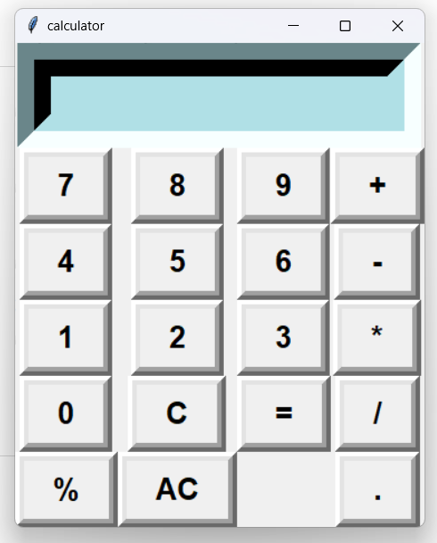
Screenshot of Calculator

Slide 6
THANK YOU

